Slide 1
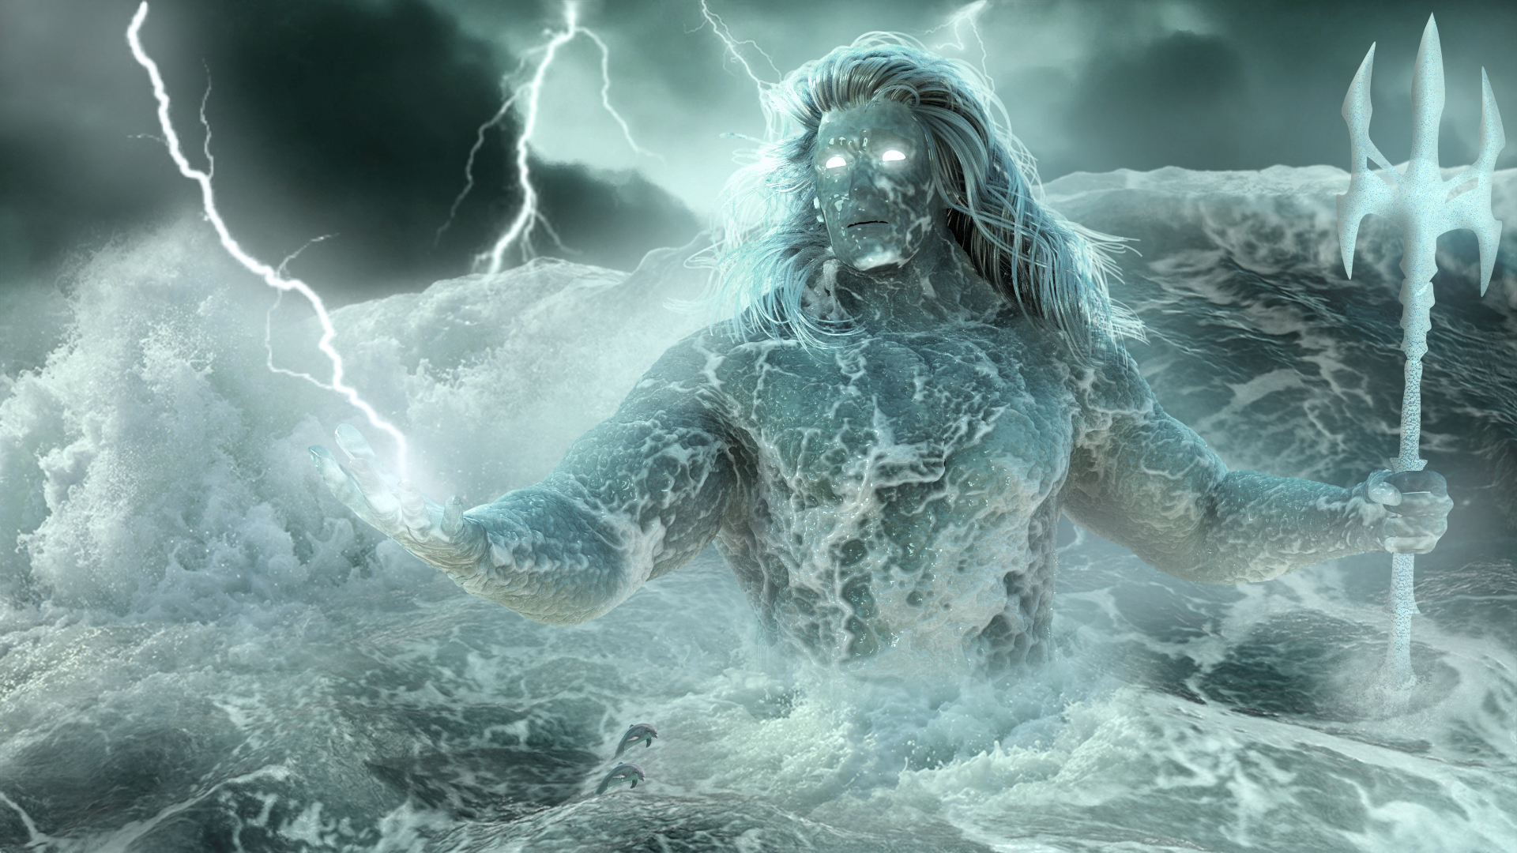
Poseidon

Slide 2
Who is Poseidon?
One of the chief Olympian deities
God of the Sea and god of horses
God of storms and earthquakes
Most primitive of the gods
Portrayed as a powerful man with a beard holding a trident
Names: "Neptune", "Supporter of Earth", "Earthshaker"

Slide 3

Personality
Primitive
Emotional
Vengeful
Power-hungry

Slide 4
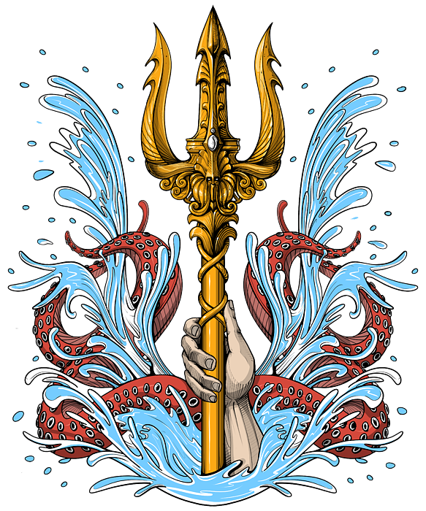
Symbols
Trident
Horse
Bull

Slide 5
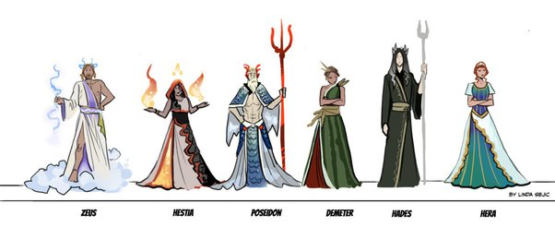
Genealogy
Grandparents: Ouranos and Gaea
Parents: Kronos (Cronus) and Rhea
Brothers: Zeus and Hades
Sisters: Hestia, Hera, and Demeter
His birth is told about in the story "Rhea's Deception"

Slide 6
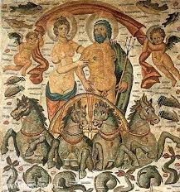
Women and His Children
Wife: Amphitrite the Nereid (raped)
Delphinus (dolphin) pleaded for their marriage, and she agreed after fleeing
Had 1 son & 2 daughters
Son: Polyphemus the Cyclops
Son: Triton the merman
Tyro (lover) and their children Neleus and Pelias
Mated with Demeter in the form of a stallion
Scylla (lover)
Charydbis (daughter of Poseidon and Ge)
Medusa the Gorgon and their son Pegasus (the winged horse) and Chrysaor (He of the Golden Sword)
Said to be the true father of Theseus, the great national hero of Athens

Slide 7
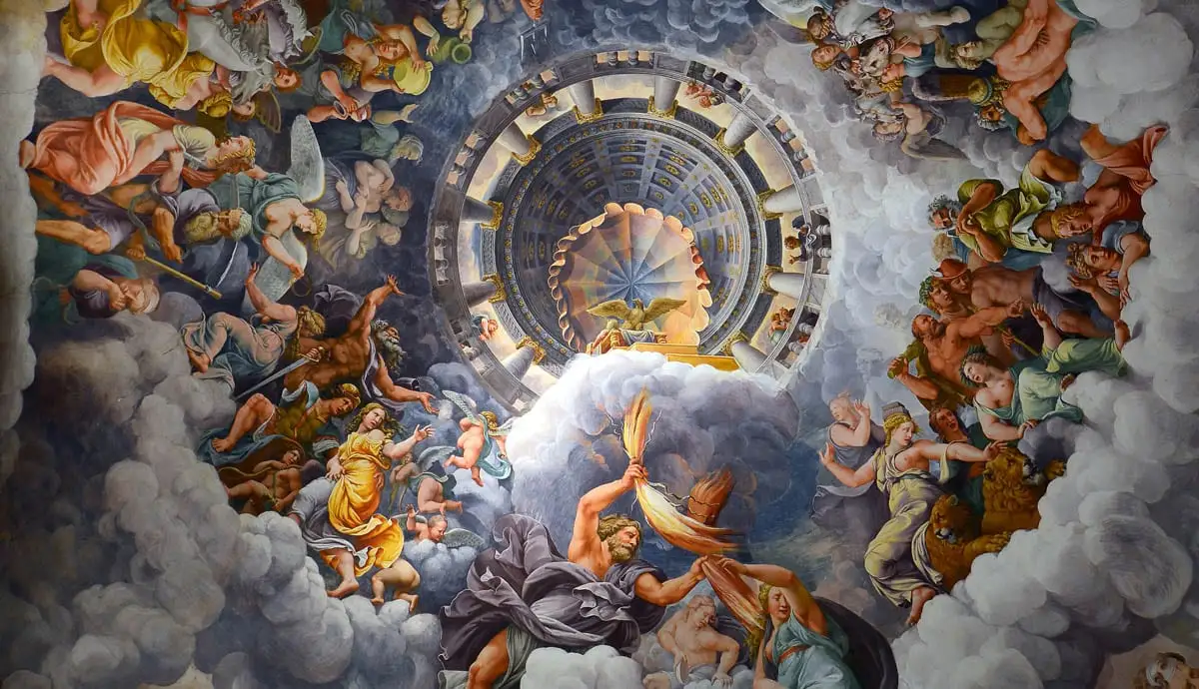
Mythology

Slide 8
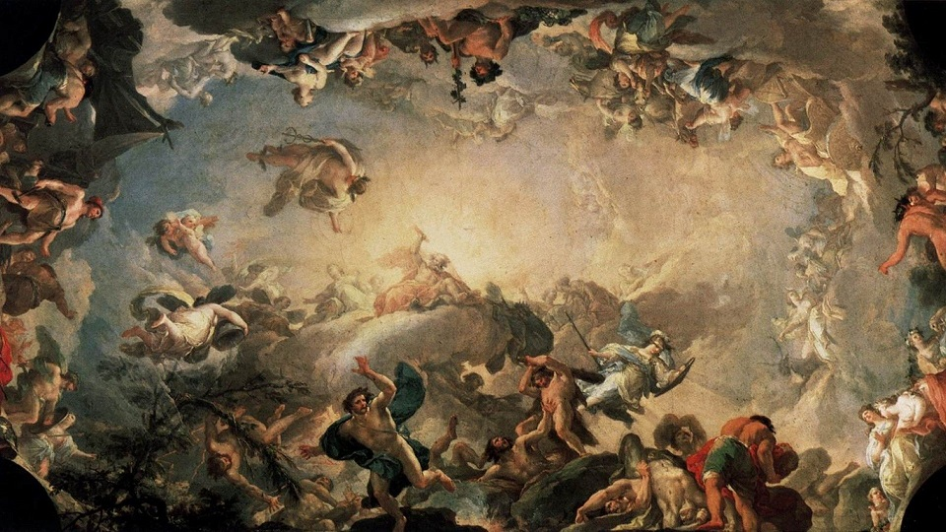
Mythology: The Titanomachy

Slide 9
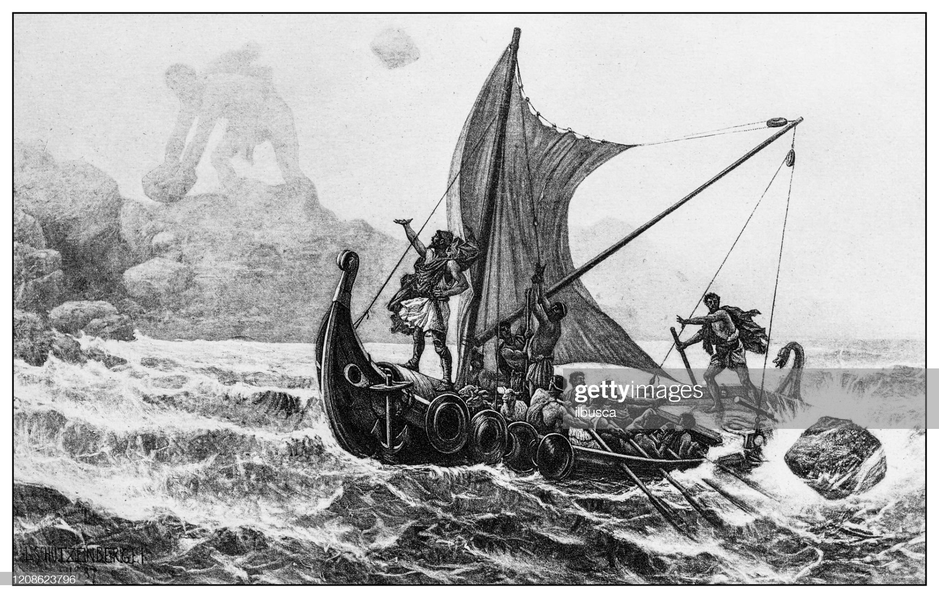
Mythology: The Odyssey

Slide 10
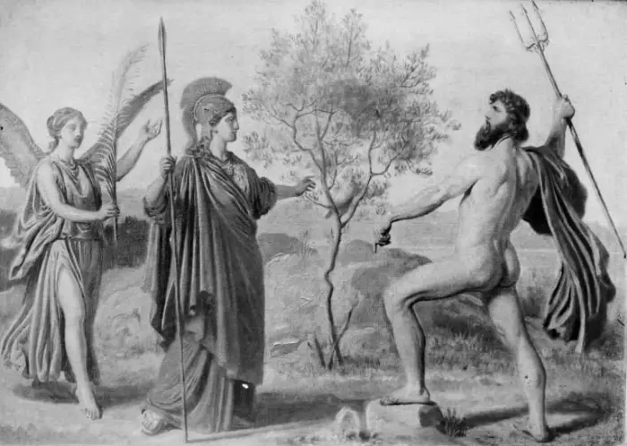
Mythology: The Contest for Athens and Argos

Slide 11


Slide 12
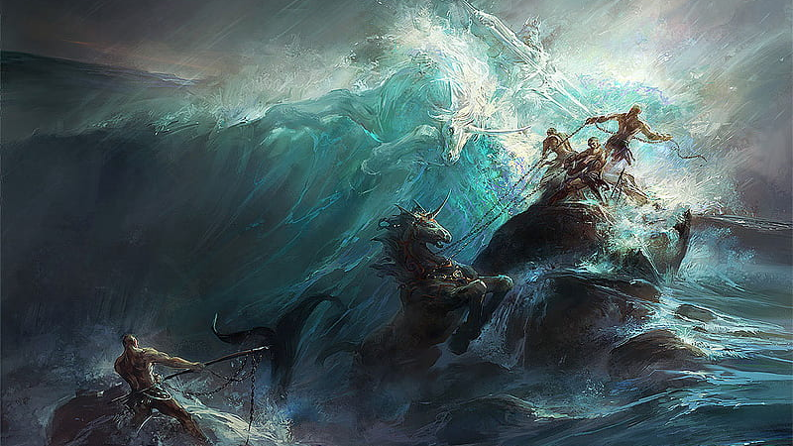
Force of Nature and Emotionality
God of storms and earthquakes
Storms
Earthquakes
Floods

Slide 13
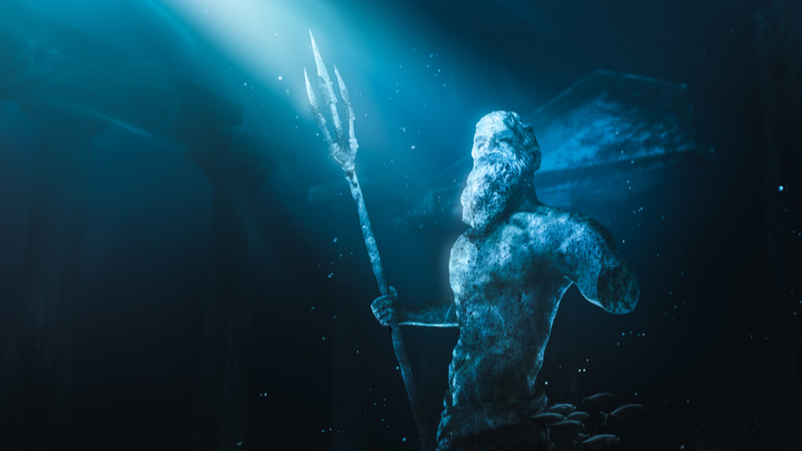
Poseidon the Archetype
Aggressive
Emotionally expressive
Often lacks intelligence and rationality
Relentless in their desires

Slide 14
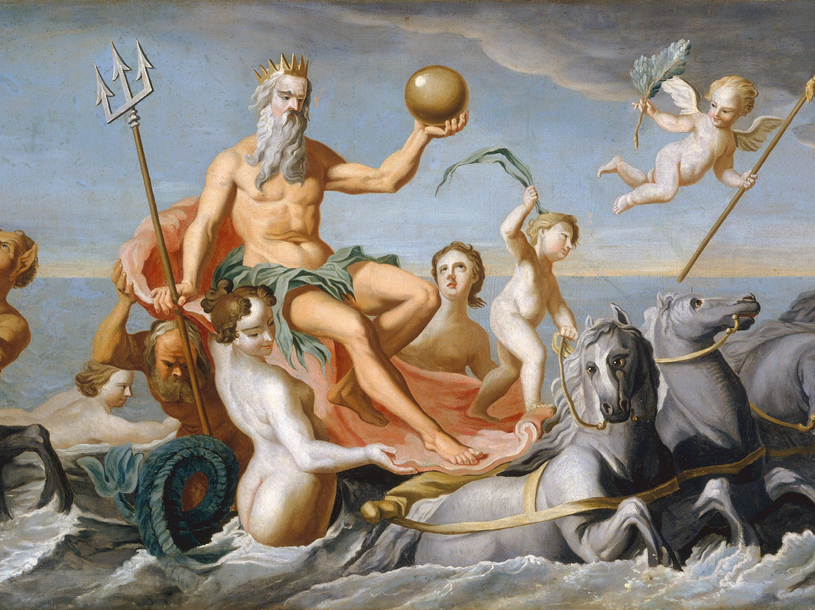
Archetype of the King

Slide 15
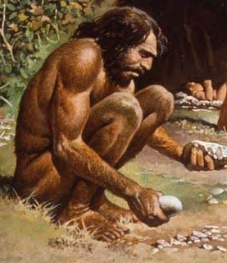
Archetype of the wildman

Slide 16

Poseidon in Everyman

Slide 17

Conclusion

Slide 18
Works Cited
Bakula, Jean. “Poseidon, Archetype of Emotion, Instinct and the Sea.” Owlcation. Owlcation, June 5, 2011. https://owlcation.com/academia/Poseidon-Greek-God-of-the-Sea.
Kapach, A. (2022, August 12). Poseidon. Mythopedia. Retrieved October 1, 2022, from https://mythopedia.com/topics/poseidon
Greek mythology. Ducksters. (n.d.). Retrieved October 1, 2022, from https://www.ducksters.com/history/ancient_greece/poseidon.php
Wikimedia Foundation. (2022, September 29). Poseidon. Wikipedia. Retrieved October 1, 2022, from https://en.wikipedia.org/wiki/Poseidon

